Slide 1

CSE 299 Junior Design Course
Rahman Farhat Lamisa
1731068042

Slide 2
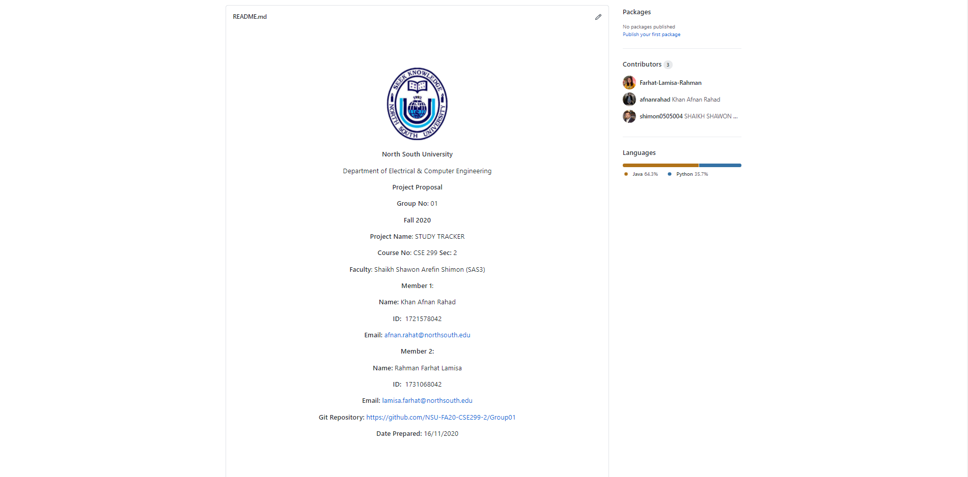
Readme.md

Slide 3
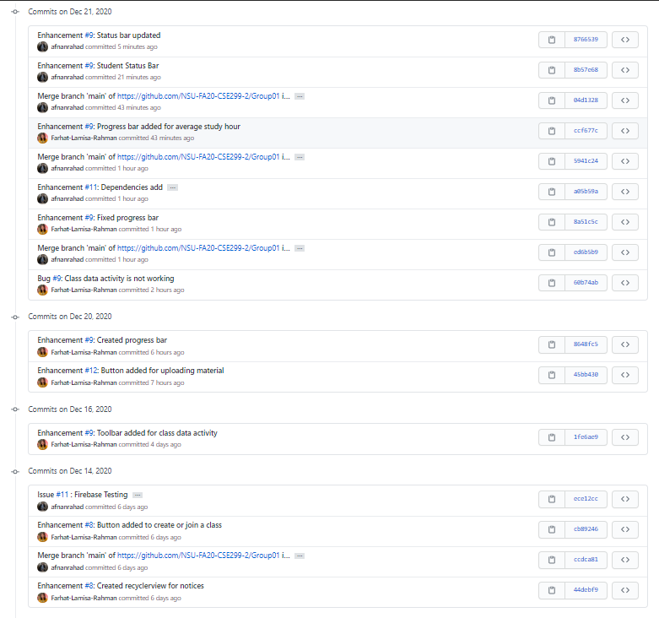
Commits

Slide 4
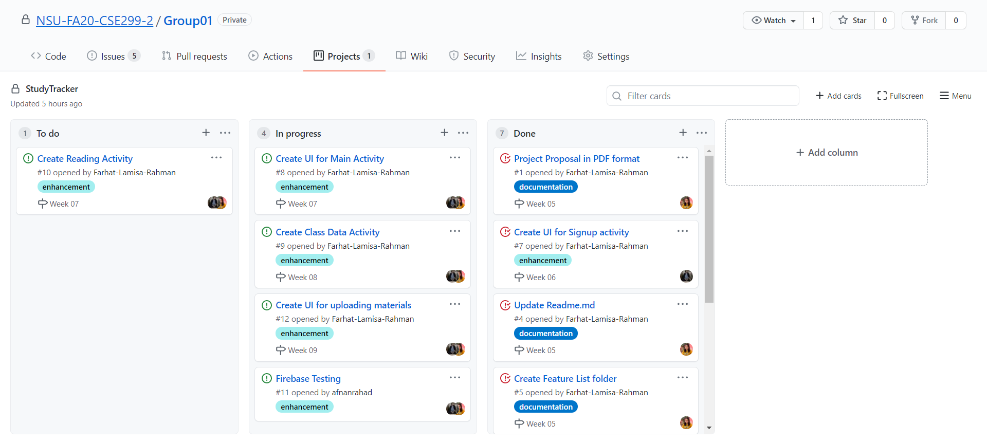
Issue Board

